Slide 1
ENTERPRISE INFORMATION SYSTEMS
CLASS ASSIGNMENT

Slide 2
FRONT END SOLUTIONS FOR INTERNET OF THINGS APPLICATION
BY
ANSHIKA BANERJEE (10372528)

Slide 3
Introduction.
The artefact in corporates two Application Enterprise Information System Technologies such as, Web Services and Oauth.
The basic aim of the artefact is to provide a front end solution to all IOT devices. This means its a place where the IOT application can display their data, which they have obtained from sensors, and other hardware modules.

Slide 4
Design.
The artefact is built on as a PWA that is a Progressive Web Application.
The PWA will pull data from ThingsSpeak.com. ThingsSpeak.com is a repository for IOT data. It is an open source website.
The data obtained from the website is in JSON/ XML/ CSV. It is transported to our PWA via APIs.
Once the data is there on the website it will be worked upon with Google Analytics APIs.

Slide 5
Design.
The data from ThingsSpeak.com to our artefact is transported via a channel setup. The APIs Key authenticates where the data is going and if it is a trusted source.
Oauth via Facebook is used to login the user into their accounts.
A user must have a Facebook Account to use the artefact.

Slide 6
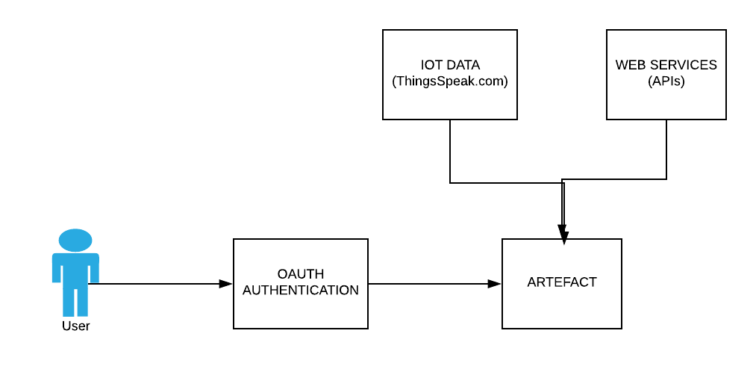
Methodology.

Slide 7
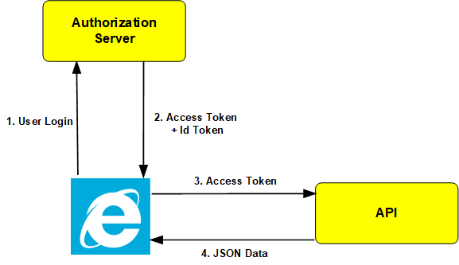
Methodology.

Slide 8
APIs USED.
Google Maps API.
YouTube Data API.
Google Graph API.
Things Speak API.
Google Analytics API.

Slide 9
Development.
Languages Used:
HTML
JavaScript
PHP
Data Used:
JSON
XML
CSV

Slide 10
Relevance.
Every device is turning into a smart device that is, its evolving into a IOT Application.
All IOT applications generate tons of data. A Temperature sensor can send data every minute/hour. A pulse sensor can send data every second. Depending on the device the amount of data generated can vary.
This data needs to be displayed in a fashion, that is understood by the end user.

Slide 11
Relevance.
Since we are dealing with data. The site need to be secure. Thus, Oauth is used to fulfil the requirement of security.
A PWA can work offline. Thus if the server is down the user will still be able to access the PWA and view previous data. Once the server is up again, It will automatically refresh itself and update the records.

Slide 12
Limitations
Due to lack of time, not all aspects of the artefact are developed.
Artefact does not contain a database.
The artefact does not support multi platform sign in.
The Oauth authentication does not work properly.

Slide 13
Obstacles.
Difficulty in coding Oauth into the PWA.
Unable to host it on server.
Encountering Paid use of Servers.
No Live server present. Thus no live streaming of data.
Time constraints.
Data Streaming issues.

Slide 14
Learning Outcomes.
Development of a PWA.
Working and Implementation of Oauth authentication.
The use of multiple Web Services. How to implement a web service into your application.
In depth knowledge of an Application Enterprise Information System Technologies.
Process and stages of Software Development.

Slide 15
SCREENSHOTS

Slide 16
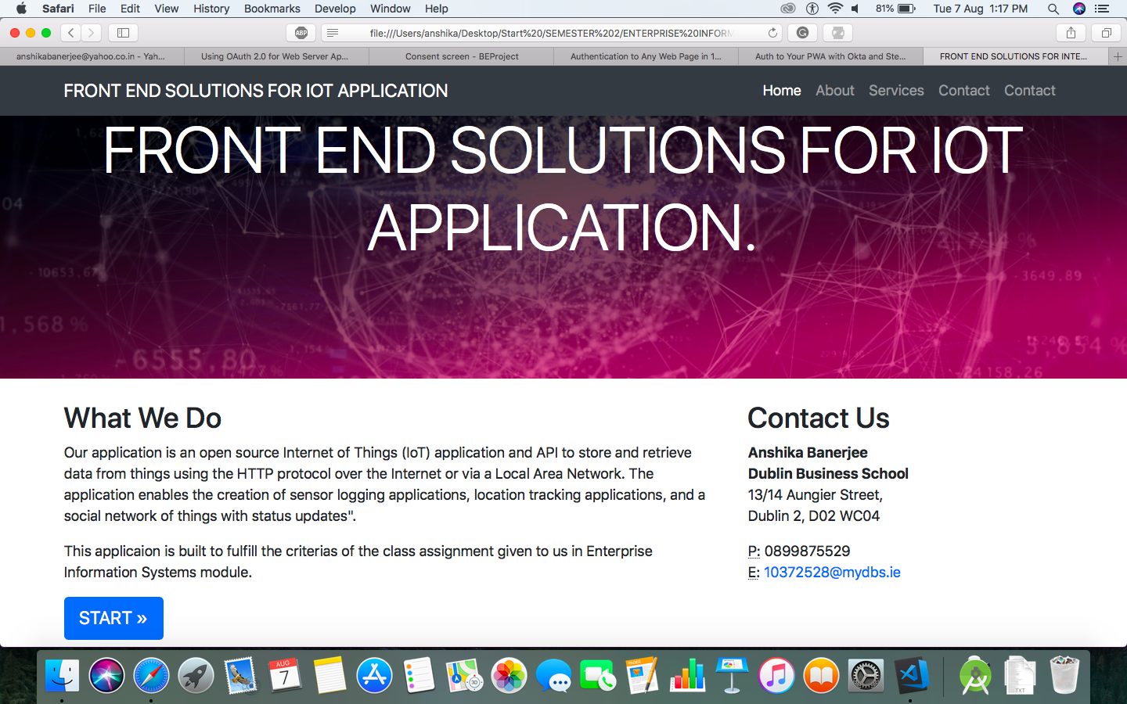

Slide 17
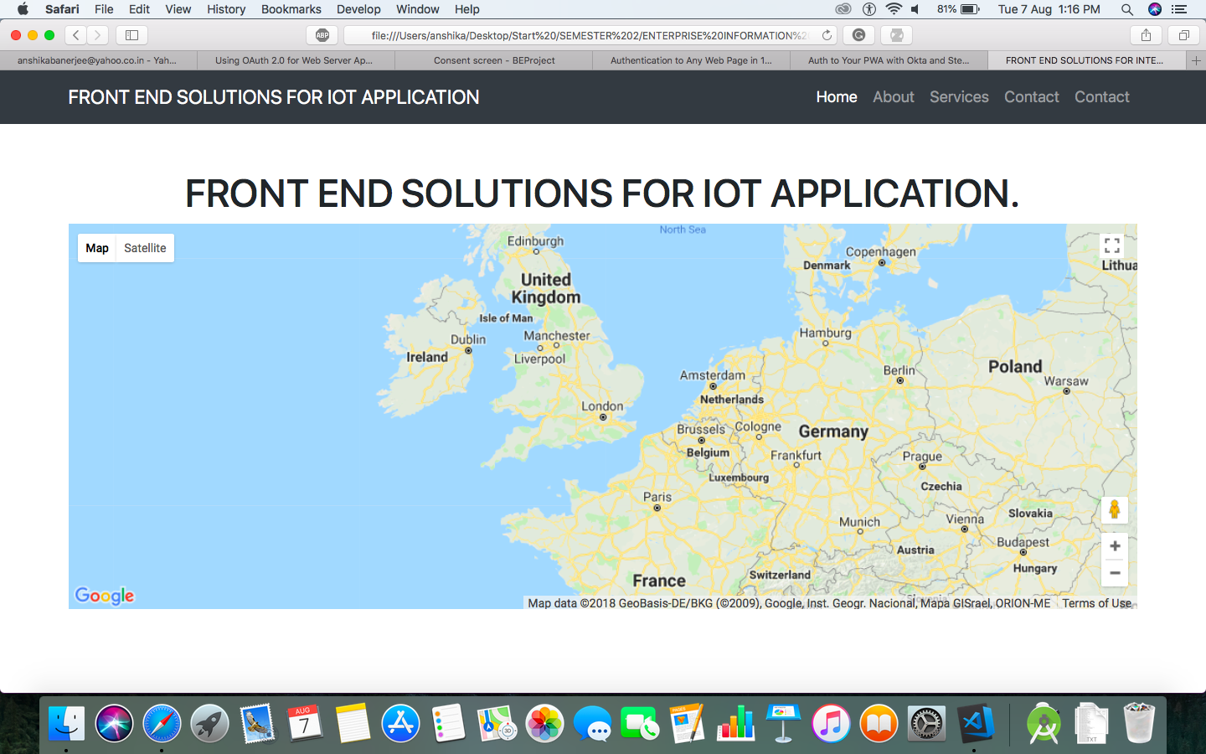

Slide 18
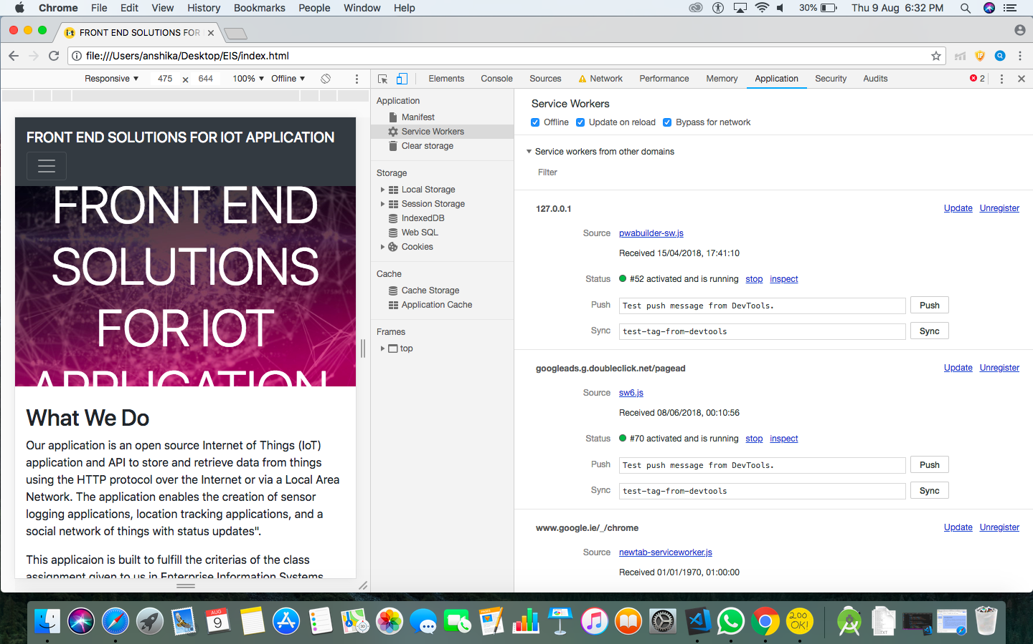

Slide 19
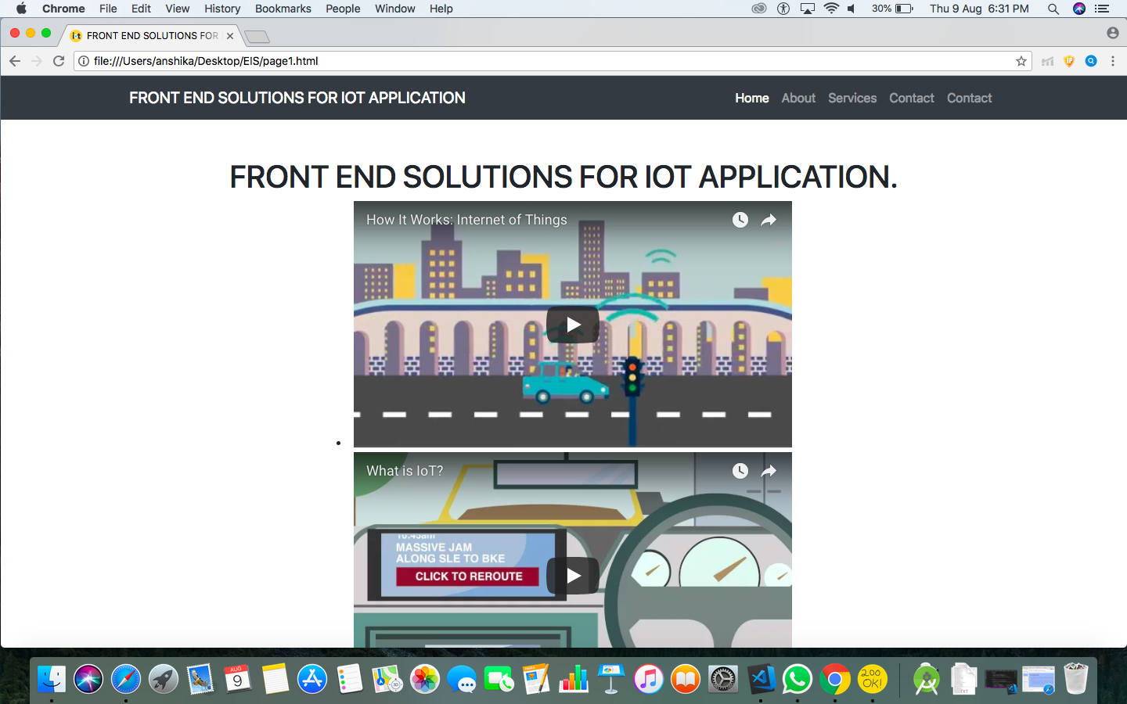

Slide 20
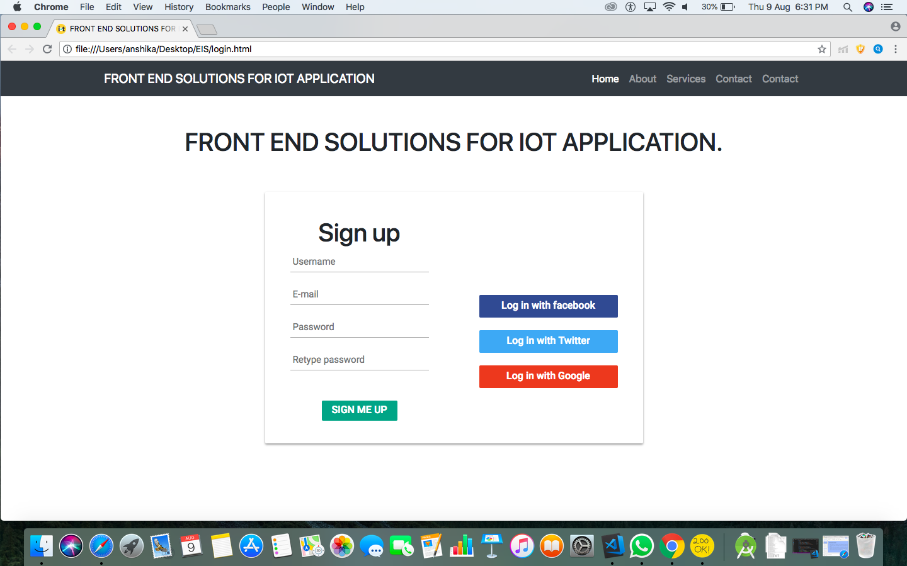

Slide 21
References.
Nordrum, A. (2016) Popular Internet of Things Forecast of 50 Billion Devices by 2020 Is Outdated, IEEE Spectrum: Technology, Engineering, and Science News. Available at: https://spectrum.ieee.org/tech-talk/telecom/internet/popular-internet-of-things-forecast- of-50-billion-devices-by-2020-is-outdated (Accessed: 22 June 2018).
OAuth: Pros and Cons of OAuth | Social Technology Review (no date). Available at: http://www.socialtechnologyreview.com/articles/oauth-pros-and-cons-oauth (Accessed: 22 June 2018).
‘Progressive web apps: key benefits, statistics, use cases’ (2017) Apiumhub, 14 September. Available at: https://apiumhub.com/tech-blog-barcelona/progressive-web-apps/ (Accessed: 22 June 2018).
https://cantabrigian-peak.000webhostapp.com/index.html

Slide 22
THANK YOU.

